Slide 1
Assessing and comparing energy systems through calculation of Energy Returned on (Energy) Invested (EROIs)?
Short introduction to the concept of ERoEI, summarizing what I have learned about it from the presentations given at the Les Houches Winter School “Science for Energy Scenarios” held in March 2016.
ERoEI = E_{out} /E_{in}
A very simple definition indeed , but …
http://science-and-energy.org/

Slide 2
Outline
Charles Hall, who introduced the concept in 1970 when studying migrating salmons, gave an overview (history, applications, issues)
Jessica Lambert has examined the possible correlations between EROIs and Quality of Life indices.
Pedro Prieto, who was in charge of the Spanish PV program, worked out the first comprehensive study of the EROI of large-scale solar PV systems in a developed country. (“Spain’s Photovoltaic Revolution. The Energy Return on Investment” Authors: Pedro Prieto, Charles Hall, Springer 2013)
EROI is a very simple concept, but there are a lot of methodology issues. How to deal with differences between various energy systems (e.g. fuels vs. power systems, …). Daniel Weißbach gave a detailed discussion followed by an application to nuclear power.
…Rather depressing conclusions. Is the maintain of our civilization compatible with a drastic energy flow decrease? What can we do, propose, as physicists?

Slide 3
Charles Hall
Charles Hall is an ecologist.
He has introduced the concept of ERoEI when trying to answer the question: why do fish migrate?
~ a minimum of 5 Calories for each Calorie invested in migration
Context and filiation:
Raymond Lindeman (with G.E. Hutchinson), who studied ecosystems and conceptualized it as energy flow in a tightly link trophic structure. He stated the 10% law in the food chain: ~ 10% of the energy from organic matter is stored as flesh during the transfer of energy from one trophic level, (i.e. position in the food chain) to the next one.
Howard Odum (doctoral advisor of Charles Hall) worked on energetics of evolution, making use of general systems theory.

Slide 4
From Charles Hall
Starting from the prehistory of Human society there was a continuous
increase in the energy flow.

Slide 5
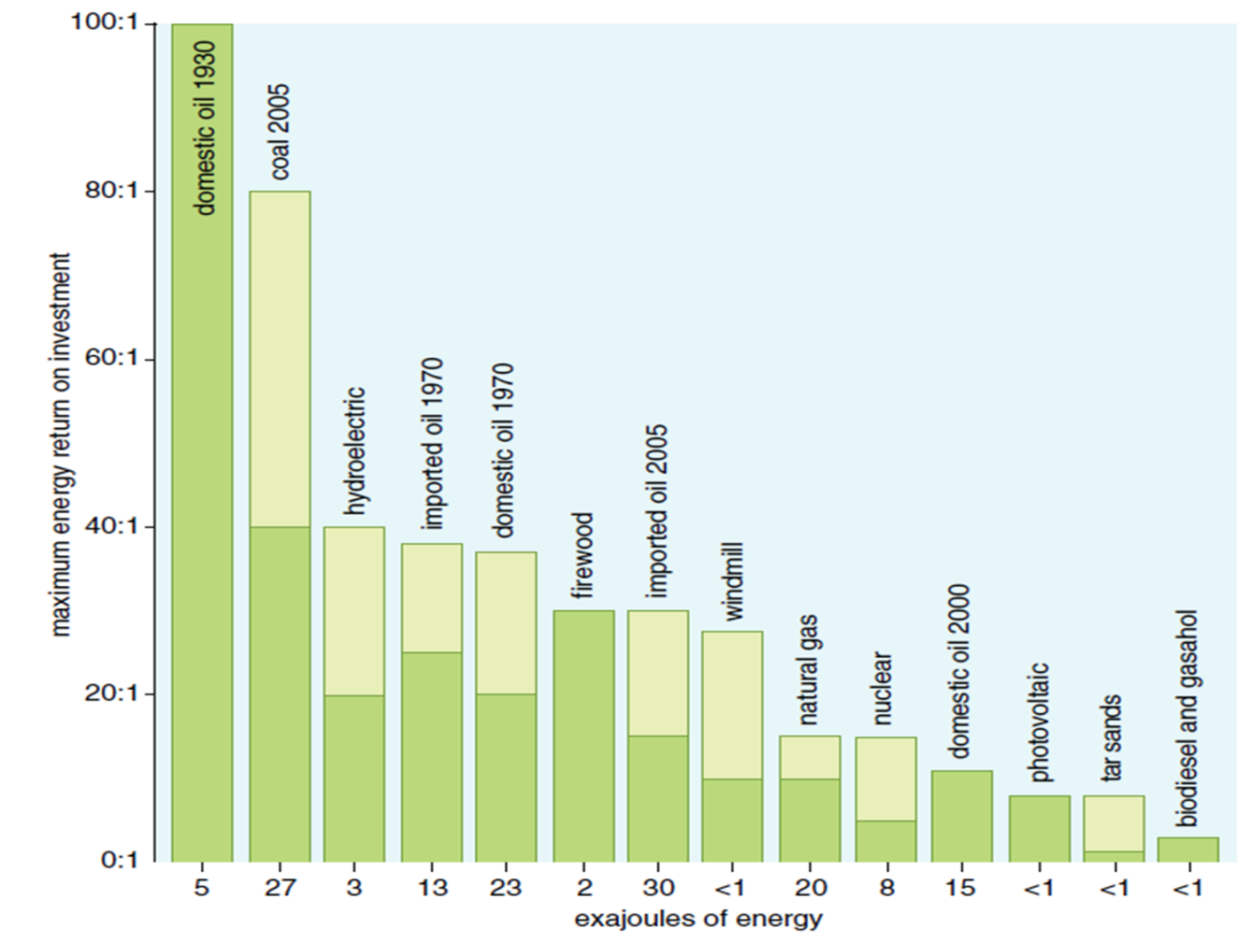
From Charles Hall
Declining EROI for conventional fuels and low values for
intermittent ‘renewable’ energy sources.
Problem: estimating and comparing EROIs for simple fuels (oil) and complex
Power systems

Slide 6
From Charles Hall

Slide 7
From Charles Hall

Slide 8
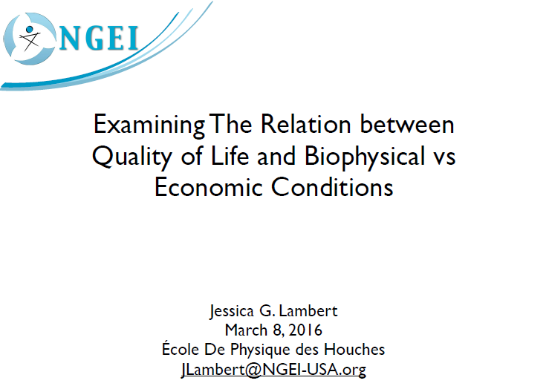
How to quantify the quality of life and find correlations with energy indices?
J. Lambert has introduced a societal EROI by mixing physical (energy per unit of fuel) and economical (price per unit of fuel, GDP) data

Slide 9
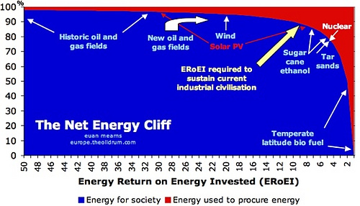
From Charles Hall and Jessica Lambert

Slide 10
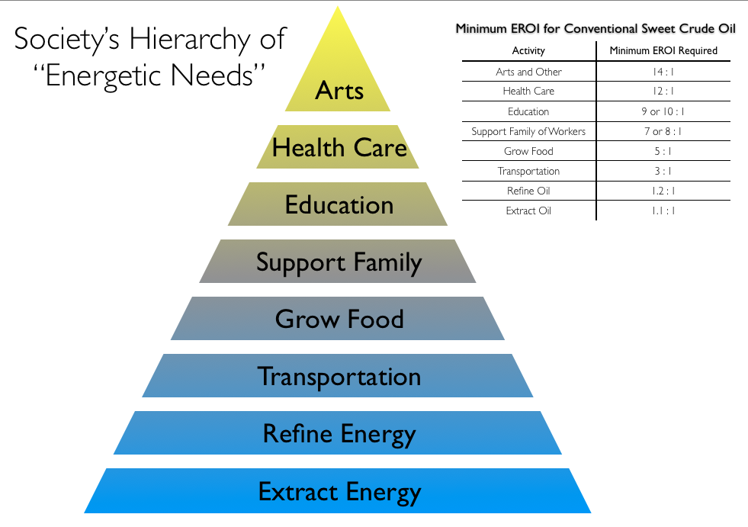
From Charles Hall and Jessica Lambert

Slide 11
From Jessica Lambert

Slide 12
The net EROI for solar PV, Pedro Prieto

Slide 13
From Pedro Prieto

Slide 14
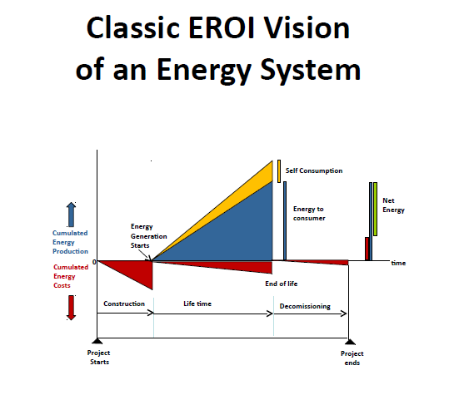
From Pedro Prieto

Slide 15
From Pedro Prieto

Slide 16
From Pedro Prieto

Slide 17
From Pedro Prieto

Slide 18
From Pedro Prieto

Slide 19
Thorough analysis of all issues coming the methodology used when calculating EROIs
Why such low values for nuclear power compared to oil?

Slide 20
From Daniel Weißbach

Slide 21
From Daniel Weißbach

Slide 23
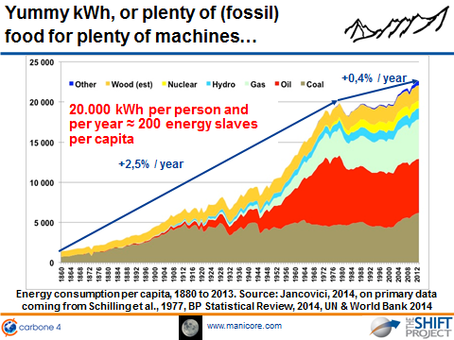
From Jean-Marc Jancovici

Slide 24
From Jean-Marc Jancovici

Slide 25
From Jean-Marc Jancovici

Slide 26
Some comments
EROI can be a powerful indicator for availability, capital costs, final price to end consumer, and in the end industrial production per capita, but still needs to be more precisely defined.
What can we do as physicists ?
Any other positive ways leading to propositions, or helping to make a choice between solutions, by making use of this concept of ERoEI?

